Slide 1
DATA STRUCTURES
CS – I
Chapter 2

Slide 2
CONTENTS
Introduction to data structures.
Data structure operations.
Algorithmic notations.
Control structures.
Arrays-Representation in memory, Traversing, Deleting, Sorting, Binary search in an array, Pointer arrays, Records in memory using array.
Linked list - Representation in memory
Trees, Binary trees - Representing binary tree in memory.

Slide 3
Introduction to Data Structure
Data : Data are simply values or set of values.
Group items : Data items which are divided into subitems are called as group items. e.g. Date may be divided into three subitems - day, month and year. So Date becomes group item.
Elementary items : Data items which are not divided into subitems are called as elementary items. e.g. pincode number cannot be divided into subitems. So it is elementary item.

Slide 4
Introduction to Data Structure (Cont…)
Entity : An entity is something that has certain attributes or properties which may be assigned values. The values themselves may be numeric or nonnumeric.
Attributes |  | Name | Age | Sex | Education
Values |  | Atul | 22 | M | S.E. (Computer)

Slide 5
Introduction to Data Structure (Cont…)
Field : Field is a single elementary unit of information representing an attribute of an entity
Record : Record is a collection of field values of a given entity.
File : File is the collection of records of the entities in a given entity set.
GRNO | Name | Age | Sex | Education
22584 | Atul | 22 | M | S.E. (Computer)
22585 | Ajay | 23 | M | S.E. (Computer)
Record
Field

Slide 6
WHAT IS Data Structure ?
Data may be organized in many different ways. Data structure is the way in which different data elements are logically related.
Collection of data elements forming an organisation characterized by the accessing functions is called data structure.
The data structure should be simple and it should show the relationship between data elements.

Slide 7
TYPES OF Data Structure
Linear data structure : In linear data structure, data elements are stored in consecutive memory locations or by using linked representation. e.g. arrays, linked list.
Non-linear data structure : In non-linear data structures, the linear order cannot be maintained between data elements. Generally data elements have hierarchical relationship between them. e.g. trees
Computer language provides different data structures like arrays, stack, queue, tree etc.

Slide 8
Data Structure OPERATIONS
Traversing : Accessing each record or element exactly once, so that it can be processed is called traversing.
Inserting : Adding a new record to the existing structure is called as inserting.
Deleting : Removing a record from the existing structure is called as deleting.
Searching : Finding the location of a record with given key values or finding the locations of all records which satisfy one or more conditions is called as searching.
Sorting : Arranging records in some logical order is called as sorting.
Merging : Merging means combining the records in two different sorted files into a single sorted file.

Slide 9
ALGORITHM
An algorithm is a finite step by step list of well-defined instructions for solving a particular problem.
An algorithm consists of two parts :
First part is a paragraph which tells the purpose of algorithm. In this part, we define variables in algorithm and lists the input data.
The second part of algorithm consists of steps in algorithm that are executed one after the another, generally beginning with step 1. The control can be transferred to step n, by the statement "go to step n".
The algorithm is completed, when the statement 'Exit' or 'Stop' is encountered.

Slide 10
ALGORITHM (EXAMPLE)
Question : Algorithm to find largest element in array.
Largest [DATA, N, MAX]
Here, DATA is a linear array with N elements. This algorithm finds the largest element MAX of DATA.
Step 1 : [Initialize counter] set k = 1 and Max = DATA [1]
Step 2 : [Compare and Update]
If MAX < DATA [k + 1],
then : MAX = DATA [k + 1]
[End of If structure]
Step 3 : [Increment counter] set k = k + 1
Step 4 : [Test counter] If k < N, then : go to step 2 [End of If structure]
Step 5 : Write : MAX
Step 6 : Exit

Slide 11
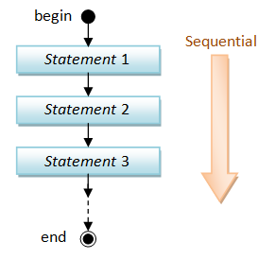
SEQUENCE LOGIC / SEQUENTIAL FLOW
In the sequence logic, statements are executed one after the other, sequentially.
The sequence may be present explicitly by means of numbered steps.

Slide 12
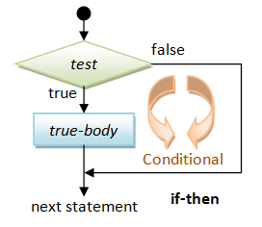
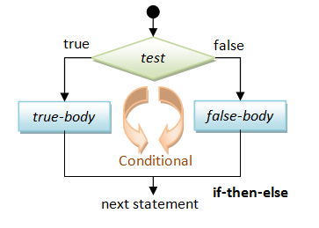
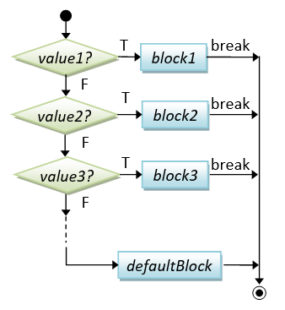
SELECTION LOGIC / CONDITIONAL FLOW
SINGLE
DOUBLE
MULTIPLE
Selection logic uses number of conditions, which cause selection of one out of several alternative modules. The structure which implement this type of logic is known as selection logic.
There are three types of conditional structures.

Slide 13
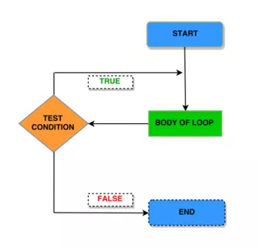
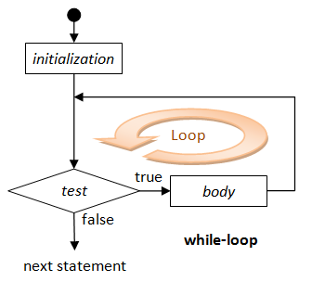
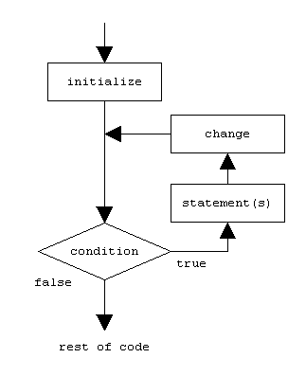
ITERATION LOGIC
Selection logic uses number of conditions, which cause selection of one out of several alternative modules. The structure which implement this type of logic is known as selection logic.
There are three types of conditional structures.

Slide 14
ARRAY (LINEAR ARRAY)
A data structure is said to be linear if its elements form a sequence.
A linear array is the data structure which consists of finite, ordered set of homogeneous data elements such that :
The elements of the array are referenced respectively by an index set (subscript) consisting of 'n' consecutive numbers.
The elements of the array are stored respectively in successive memory locations.
The number 'n' of the elements is called length or size of array. In general, the size or length of the array can be obtained from the index set by the formula:-
LENGTH = UB – LB + 1

Slide 15
ALGORITHM – TRAVERSING AN ARRAY
Here LA is a linear array with lower bound LB and upper bound UB. Following algorithm apply operation PROCESS to each element of LA.
SOLUTION - I
SOLUTION - II
Step 1 : [Initialize counter] set K = LB
Step 2 : Repeat steps 3 and 4 while K<=UB
Step 3 : [Visit element]
Apply PROCESS to LA[K]
Step 4 : [Increment counter] set K = K + 1
[End of step 2 loop]
Step 5 : Exit
Step 1 : Repeat FOR K = LB to UB
[Visit element] Apply PROCESS to LA[K]
[End of FOR loop]
Step 2 : Exit

Slide 16
ALGORITHM – TRAVERSING AN ARRAY
BOARD PRACTICAL : Write a program in C++ that first initializes an array of five given numbers (short /float/ double). The program must add these numbers by traversing this array with a pointer. The output should print the starting address of the array with the size of the number (in bytes) to which it points. The program must also print the sum and pointer address with addition of every number as well as the ending address.

Slide 17
ALGORITHM – TRAVERSING AN ARRAY (BOARD PRACTICAL SOLUTION)
#include<iostream.h>
#include<conio.h>
void main()
{
clrscr();
float a[] = {5.5, 4.4, 3.3, 2.2, 1.1}, sum = 0;
int i;
cout<<"\n The base address of the array is : "<<a;
cout<<"\n The base element of the array is : "<<*a;
cout<<"\n The size of the element to which the pointer is pointing : "<<sizeof(*a)<<" bytes";

Slide 18
ALGORITHM – TRAVERSING AN ARRAY(BOARD PRACTICAL SOLUTION)
for(i=0; i<5 ; i++)
{
sum = sum + *(a+i);
cout<<"\n The "<<(i+1)<<" element in the array is : "<<*(a+i)<<" and its address is : "<<(a+i);
cout<<"\n The sum of first "<<(i+1)<<" element(s) is : "<<sum;
}
cout<<"\n The ending address of the array is : "<<(a+4);
cout<<"\n The ending element of the array is : "<<*(a+4);
getch();
}

Slide 19
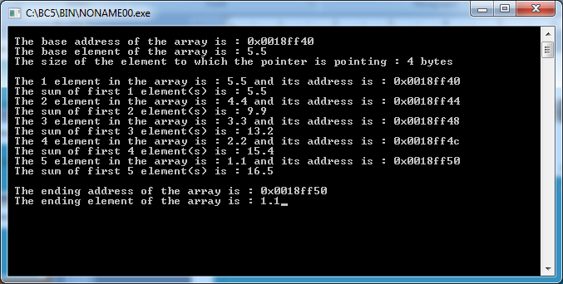
ALGORITHM – TRAVERSING AN ARRAY(BOARD PRACTICAL SOLUTION)

Slide 20
ALGORITHM – INSERTING AN ELEMENT IN A LINEAR ARRAY
INSERT (LA, N, K, ITEM) : Here LA is a linear array with N elements and K is a positive integer, such that K <= N. This algorithm inserts an element ITEM at K" position in LA.
Step 1 : [Initialize counter] set J = N
Step 2 : Repeat steps 3 and 4 while J>=K
Step 3 : [Move J^{th} element forward]
Set LA[J + 1] = LA[J][Decrement counter]
Step 4 : [Decrement counter] set J = J – 1
[End of step 2 loop]
Step 5 : [Insert the element]
set LA[K] = ITEM
Step 6 : [Reset N] Set N = N + 1
Step 7 : Exit

Slide 21
ALGORITHM – INSERTING AN ELEMENT IN A LINEAR ARRAY
Following C++ program ask to the user to enter array size, then ask to the user to enter array element, then ask to the user to enter element or number to be insert, then at last it will ask to the user to enter the position (index number) where he or she want to insert the desired element in the array, so this program insert the desired element and display the new array on the screen after inserting the element:
void main()
{
clrscr();
int arr[50], size, insert, i, pos;
cout<<"Enter Array Size : ";
cin>>size;
cout<<"Enter array elements : ";
for(i=0; i<size; i++)
{
cin>>arr[i];
}

Slide 22
ALGORITHM – INSERTING AN ELEMENT IN A LINEAR ARRAY
cout<<"Enter element to be insert : ";
cin>>insert;
cout<<"At which position (Enter index number) ? ";
cin>>pos;
// now create a space at the required position
for(i=size; i>pos; i--)
{
arr[i]=arr[i-1];
}

Slide 23
ALGORITHM – INSERTING AN ELEMENT IN A LINEAR ARRAY
arr[pos]=insert;
cout<<"Element inserted successfully..!!\n";
cout<<"Now the new array is : \n";
for(i=0; i<size+1; i++)
{
cout<<arr[i]<<" ";
}
getch();
}

Slide 24
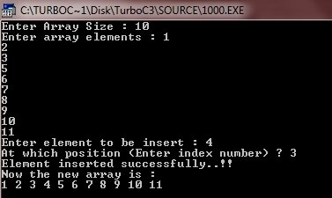
ALGORITHM – INSERTING AN ELEMENT IN A LINEAR ARRAY

Slide 25
ALGORITHM – DELETING AN ELEMENT FROM AN LINEAR ARRAY
DELETE (LA, N, K, ITEM) : Here LA is a linear array with N elements and K is a positive integer, such that K <= N. This algorithm deletes K^{th} element from LA and assigns it to variable ITEM.
Step 1 : Set ITEM = LA[K]
Step 2 : Repeat FOR J=K to (N – 1)
[Move (J+1)^{th} element backward]
Set LA[J] = LA[J+1]
[End of FOR loop]
Step 3 : [Reset N] Set N = N - 1
Step 4 : Exit

Slide 26
ALGORITHM – DELETING AN ELEMENT FROM AN LINEAR ARRAY
Following C++ program ask to the user to enter array size, then enter array elements then it will ask to enter element to be delete, to delete the desired element from the array, then display the new array on the screen:
void main()
{
clrscr();
int arr[50], size, i, del, count=0;
cout<<"Enter array size : ";
cin>>size;
cout<<"Enter array elements : ";
for(i=0; i<size; i++)
{
cin>>arr[i];
}

Slide 27
ALGORITHM – DELETING AN ELEMENT FROM AN LINEAR ARRAY
cout<<"Enter element to be delete : ";
cin>>del;
for(i=0; i<size; i++)
{
if(arr[i]==del)
{
for(int j=i; j<(size-1); j++)
{
arr[j]=arr[j+1];
}
count++;
break;
}
}

Slide 28
ALGORITHM – DELETING AN ELEMENT FROM AN LINEAR ARRAY
if(count==0)
{
cout<<"Element not found..!!";
}
else
{
cout<<"Element deleted successfully..!!\n";
cout<<"Now the new array is :\n";
for(i=0; i<(size-1); i++)
{
cout<<arr[i]<<" ";
}
}
getch();
}

Slide 29
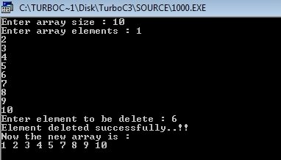
ALGORITHM – DELETING AN ELEMENT FROM AN LINEAR ARRAY

Slide 30
ALGORITHM – BUBBLE SORT
Bubble Sort (DATA, N) : Here DATA is a linear array with N elements. This algorithm sorts elements of DATA in ascending order.
Step 1 : Repeat Steps 2 and 3, FOR K = 1 to (N – 1)
Step 2 : Set Ptr = 1
Step 3 : Repeat WHILE Ptr <= (N – K)
(a) If DATA [Ptr] > DATA [Ptr + 1], then interchange, DATA [Ptr] and DATA [Ptr + 1]
[End of If structure]
(b) [Increment pointer] Set ptr = ptr+1
[End of inner loop]
[End of outer loop]
Step 4 : Exit

Slide 31
ALGORITHM – BUBBLE SORT
BOARD PRACTICAL : Write a program in C++ that first initializes an array of given 10 real numbers. The program must sort numbers in ascending/descending order using Bubble – Sort method. It should print the given list of numbers as well as the sorted list.
void main()
{
clrscr();
float a[10]={1.2, 9.2, 7.6, 5.4, 3.4, 4.1, 1.5, 6.3, 4.3, 2.3}, t;
int i,j;
cout<<“Before sorting array elements are : “;
for(i=0;i<10;i++)
{
cout<<a[i]<<” “;
}

Slide 32
ALGORITHM – BUBBLE SORT
for(i=0; i<10-1; i++)
{
for(j=0; j<10-i-1; j++)
{
if(a[j]>a[j+1])
{
t=a[j];
a[j]=a[j+1];
a[j+1]=t;
}
}
}

Slide 33
ALGORITHM – BUBBLE SORT
cout<<“After sorting array elements are : “;
for(i=0;i<10;i++)
{
cout<<a[i]<<” “;
}
getch();
}

Slide 34
ALGORITHM – BUBBLE SORT

Slide 35
ALGORITHM – LINEAR SEARCH
LINEAR(DATA, N, ITEM, LOC) : Here DATA is a linear array with N elements and ITEM is given element. This algorithm finds the location LOC of ITEM in DATA or sets LOC = 0, if search is unsuccessful.

Slide 36
ALGORITHM – LINEAR SEARCH
LINEAR(DATA, N, ITEM, LOC) : Here DATA is a linear array with N elements and ITEM is given element. This algorithm finds the location LOC of ITEM in DATA or sets LOC = 0, if search is unsuccessful.
Step1: [Initialize counter]
Set LOC = 1
Step 2 : [Search for item]
Repeat While DATA [LOC] != ITEM
Set LOC = LOC +1
[End of loop]
Step 3 : If LOC = N +1, then:
Set LOC = 0
Step 4 : Exit
SOLUTION - II
Step 1 : Repeat FOR LOC = 0 to N – 1
If DATA [LOC] = ITEM then,
Display LOC
EXIT
[End of IF]
[End of FOR loop]
Step 2 : Display “ELEMENT NOT FOUND”
Step 3 : Exit

Slide 37
ALGORITHM – LINEAR SEARCH
Following C++ program first ask to the user to enter the array size then it will ask to enter the array elements, then it will finally ask to enter a number to be search in the given array to check whether it is present in the array or not, if it is present then at which position :
void main()
{
clrscr();
int arr[10], i, num, n, c=0, pos;
cout<<"Enter the array size : ";
cin>>n;
cout<<"Enter Array Elements : ";
for(i=0; i<n; i++)
{
cin>>arr[i];
}

Slide 38
ALGORITHM – LINEAR SEARCH
cout<<"Enter the number to be search : ";
cin>>num;
for(i=0; i<n; i++)
{
if(arr[i]==num)
{
c=1;
pos=i+1;
break;
}
}

Slide 39
ALGORITHM – LINEAR SEARCH
if(c==0)
{
cout<<"Number not found..!!";
}
else
{
cout<<num<<" found at position "<<pos;
}
getch();
}

Slide 40
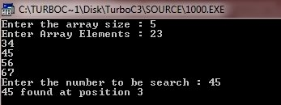
ALGORITHM – LINEAR SEARCH

Slide 41
ALGORITHM – BINARY SEARCH
Binary search is used to search an element from sorted array.
Binary (DATA, LB, UB, ITEM, LOC) : Here DATA is a sorted array with lower bound LB and upper bound UB. ITEM is given element. BEG denotes beginning, MID denotes middle and END denotes end location of DATA. This algorithm finds the location LOC of ITEM in DATA or sets LOC = NULL, if search is unsuccessful.
Advantages of binary search algorithm :
Binary search algorithm is efficient as the search scope gets reduced to half the size of the array, with each iteration.
The number of comparisons required are approximately equal to log₂n which are less than linear search.
Dis-Advantages of binary search algorithm :
The access of list must be random means the middle element can be accessed.
The given list must be sorted.
At each iteration, middle entry calculation is required.

Slide 42
ALGORITHM – BINARY SEARCH
Step 1: [Initialize Variables]
Set BEG = LB, END = UB and MID = INT ((BEG + END)/2)
Step 2: Repeat steps 3 and 4 WHILE BEG <= END AND DATA[MID] != ITEM
Step 3: If ITEM < DATA[MID] then :
Set END = (MID – 1)
Else :
Set BEG = (MID + 1)
[End of If structure]
Step 4: Set MID = INT ((BEG + END)/2)
[End of step 2 loop]
Step 5: If DATA[MID] = ITEM then :
Set LOC = MID
Else :
LOC = NULL
[End of If structure]
Step 6: Exit

Slide 43
How Binary Search Works?
For a binary search to work, it is mandatory for the target array to be sorted. We shall learn the process of binary search with a pictorial example. The following is our sorted array and let us assume that we need to search the location of value 31 using binary search.

Slide 44
How Binary Search Works?
First, we shall determine half of the array by using this formula −
Here it is, 0 + (9 - 0 ) / 2 = 4 (integer value of 4.5). So, 4 is the mid of the array.
Now we compare the value stored at location 4, with the value being searched, i.e. 31. We find that the value at location 4 is 27, which is not a match. As the value is greater than 27 and we have a sorted array, so we also know that the target value must be in the upper portion of the array.
mid = (high + low) / 2 = (9 + 0) / 2 = 4.5 = 4

Slide 45
How Binary Search Works?
We change our low to mid + 1 and find the new mid value again.
Our new mid is 7 now. We compare the value stored at location 7 with our target value 31.
The value stored at location 7 is not a match, rather it is more than what we are looking for. So, the value must be in the lower part from this location.
low = mid + 1 = 4 + 1 = 5
mid = (high + low) / 2 = (9 +5) = 14 / 2 = 7

Slide 46
How Binary Search Works?
We change our high to mid – 1 and find the new mid value again.
Our new mid is 5 now. We compare the value stored at location 5 with our target value 31.
We find that it is a match.
We conclude that the target value 31 is stored at location 5.
high = mid – 1 = 7 – 1 = 6
mid = (high + low) / 2 = (6 +5) = 11 / 2 = 5.5 = 5

Slide 47
BINARY SEARCH
BOARD PRACTICAL : Write a program in C++ that first initializes an array of given 10 sorted real numbers. The program must verify whether a given element belongs this array or not, using Binary – Search technique. The element (to be searched) is to be entered at the time of execution. If the number is found, the program should print its position in the array otherwise it should print “The number is not found.”

Slide 48
BINARY SEARCH
#include<iostream.h>
#include<conio.h>
#include<process.h>
void main()
{
clrscr();
int lb,ub,mid,i;
float a[10]={1.2,1.5,2.2,2.3,2.5,3.2,3.3,3.5,4.2,4.5},x;
cout<<"Array Elements Are :\n";
for(i=0;i<10;i++)
{
cout<<a[i]<<" ";
}

Slide 49
BINARY SEARCH
lb=0,ub=9;
cout<<"\n\n-----INPUT-----\n";
cout<<"\nEnter The Value To Be Searched ";
cin>>x;
cout<<"\n-----OUTPUT-----\n";

Slide 50
BINARY SEARCH
while(lb<=ub)
{
mid=(lb+ub)/2;
if(a[mid]==x)
{
cout<<"\nElement Is Found At Location "<<mid+1;
getch();
exit(0);
}

Slide 51
BINARY SEARCH
else if(x>a[mid])
{
lb=mid+1;
}
else
{
ub=mid-1;
}
}
cout<<"\nElement Is Not Present";
getch();
}

Slide 52
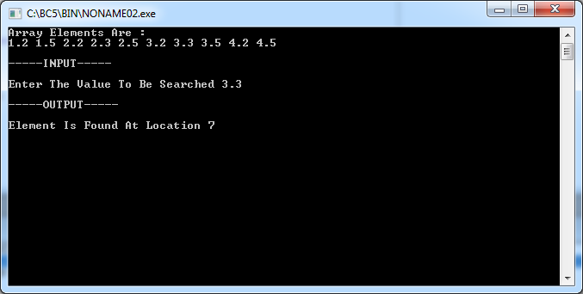
BINARY SEARCH
CASE – I : ELEMENT FOUND !!!

Slide 53
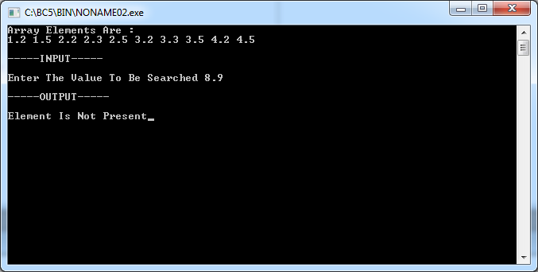
BINARY SEARCH
CASE – II : ELEMENT NOT FOUND !!!

